Slide 1
LAB#6
Sorting

Slide 2
Overview
Before we go to our lesson we must know about :
data structure .
Algorithms .
data structure is an arrangement of data in a computer’s memory (or sometimes on a disk). Data structures include linked lists, arry , stacks, binary trees, and hash tables.
Algorithms is manipulate the data in these structures in various ways, such as inserting a new data item, searching for a particular item, or sorting the items.

Slide 3
Type of Sorting
Insertion sort
Selection sort
Bubble sort
Quick sort
Merge Sort

Slide 4
Insertion sort
Insertion sort
  In the outer for loop, out starts at 1 and moves right. It marks the leftmost unsorted data.
  In the inner while loop, in starts at out and moves left, until either temp is smaller than the array element there, or it can’t go left any further.
  Each pass through the while loop shifts another sorted element one space right.

Slide 5
void insertionSort(int numbers[], int array_size)
{
int i, j, index;
for (i=1; i < array_size; i++)
{index = numbers[i];
j = i;
while ((j > 0) && (numbers[j-1] > index))
{numbers[j] = numbers[j-1];
j = j - 1;
}
numbers[j] = index;
}
}
outer loop
Inner loop

Slide 6
Insertion sort
Example #1: Show the steps of sorting the following array:
8 | 6 | 1 | 4
6 | 8 | 1 | 4
6 | 8 | 1 | 4
6 | 1 | 8 | 4
1 | 6 | 8 | 4
1 | 6 | 8 | 4
1 | 6 | 4 | 8
1 | 4 | 6 | 8
1 | 4 | 6 | 8
8 6 1 4

Slide 7
Insertion sort
Example #2: Show the steps of sorting the following array:
3 | -1 | 5 | 2
-1 | 3 | 5 | 2
-1 | 3 | 5 | 2
-1 | 3 | 5 | 2
-1 | 3 | 2 | 5
-1 | 2 | 3 | 5
-1 | 2 | 3 | 5
3 -1 5 7

Slide 8
Selection sort
Selection Sort :
Find the minimum value in the list
Swap it with the value in the first position
Repeat the steps above for the remainder of the list (starting at the second position and advancing each time)

Slide 9
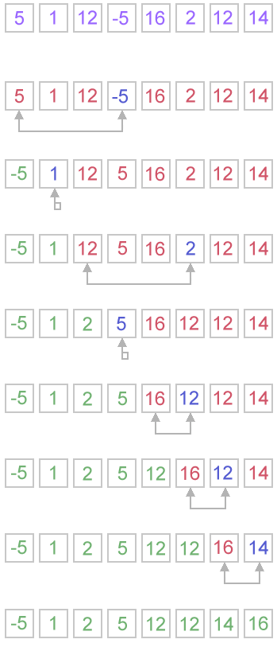

Slide 10
void SelectionSort(int A[], int length)
{ int i, j, min, minat;
for(i = 0; i<(length-1); i++)
{
minat = i;
min = A[i];
for(j = i+1;j < length; j++) //select the min of the rest of array
{
if(min > A[j]) //ascending order for descending reverse
{
minat = j; //the position of the min element
min = A[j];
}
}
int temp = A[i];
A[i] = A[minat]; //swap
A[minat]=temp;
}
}//end selection sort
Code for select the min
Code for swap

Slide 11
Selection sort
Example #1: Show the steps of sorting the following array:
8 | 6 | 1 | 4
1 | 6 | 8 | 4
1 | 6 | 8 | 4
1 | 4 | 8 | 6
1 | 4 | 8 | 6
1 | 4 | 6 | 8
1 | 4 | 6 | 8
8 6 1 4

Slide 12
Selection sort
Example #2: Show the steps of sorting the following array:
3 | -1 | 5 | 2
-1 | 3 | 5 | 2
-1 | 3 | 5 | 2
-1 | 2 | 5 | 3
-1 | 2 | 5 | 3
-1 | 2 | 3 | 5
-1 | 2 | 3 | 5
3 -1 5 2

Slide 13
Bubble sort
Bubble Sort :
compares the first two elements
If the first is greater than the second, swaps them
continues doing this for each pair of elements
Starts again with the first two elements, repeating until no swaps have occurred on the last pass

Slide 14
void bubble(int a[ ],int n)
{
int i,t;
for(i=n-2;i>=0;i--)
{
for(j=0;j<=i;j++)
{
if(a[j]>a[j+1])
{
t=a[j];
a[j]=a[j+1];
a[j+1]=t;
}
}
}//end for 1.
}//end function.
Code for swap

Slide 15
Bubble sort
Example #1: Show the steps of sorting the following array:
8 | 6 | 1 | 4
6 | 8 | 1 | 4
6 | 1 | 8 | 4
6 | 1 | 4 | 8
1 | 6 | 4 | 8
1 | 4 | 6 | 8
1 | 4 | 6 | 8
8 6 1 4

Slide 16
Bubble sort
Example #2: Show the steps of sorting the following array:
3 | -1 | 5 | 2
-1 | 3 | 5 | 2
-1 | 3 | 5 | 2
-1 | 3 | 2 | 5
-1 | 3 | 2 | 5
-1 | 2 | 3 | 5
-1 | 2 | 3 | 5
3 -1 5 2

Slide 17
Quick sort
Quick Sort :
Quick sort is a divide and conquer algorithm. Quick sort first divides a large list into two smaller sub-lists: the low elements and the high elements. Quick sort can then recursively sort the sub-lists.
A Quick sort works as follows:
Choose a pivot value: We take the value of the middle element , but it can be any value.
Partition.
Sort both part: Apply quick sort algorithm recursively to the left and the right parts.

Slide 18
Quick sort
Example #1: Show the steps of sorting the following array:
3 | -1 | 5 | 2
3 | -1 | 5 | 2
2 | -1 | 5 | 3
2 | -1 | 5 | 3
2 | -1 | 5 | 3
2 | -1 | 5 | 3
-1 | 2 | 3 | 5
3 -1 5 2

Slide 19
Quick sort
8 | 6 | 1 | 5 | 9 | 4
4 | 6 | 1 | 5 | 9 | 8
4 | 6 | 1 | 5 | 9 | 8
4 | 6 | 1 | 5 | 9 | 8
4 | 1 | 6 | 5 | 9 | 8
4 | 1 | 6 | 5 | 9 | 8
4 | 1 | 6 | 5 | 9 | 8
4 | 1 | 6 | 5 | 9 | 8
1 | 4 | 6 | 5 | 8 | 9
1 | 4 | 6 | 5 | 8 | 9
1 | 4 | 6 | 5 | 8 | 9
1 | 4 | 5 | 6 | 8 | 9
Example #2: Show the steps of sorting the following array:
8 6 1 5 9 4

Slide 20
Merge Sort
Merge Sort :
Merge sort is a much more efficient sorting technique than the bubble Sort and the insertion Sort at least in terms of speed.
A merge sort works as follows:
Divide the unsorted list into two sub lists of about half the size. Sort each sub list recursively by re-applying the merge sort.
Merge the two sub lists back into one sorted list.

Slide 21
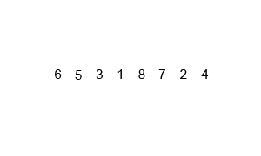
Merge Sort
Example #1: Show the steps of sorting the following array:
6 5 3 1 8 7 2 4

Slide 22
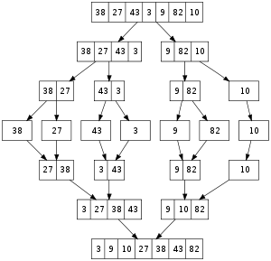
Merge Sort
Example #2: Show the steps of sorting the following array:
38 27 43 3 9 82 10

Slide 23
LAB#6
Searching

Slide 24
Linear Search
Linear Search :
Linear Search : Search an array or list by checking items one at a time.
Linear search is usually very simple to implement, and is practical when the list has only a few elements, or when performing a single search in an unordered list.

Slide 25
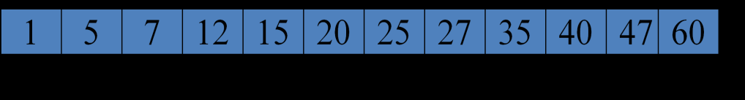
Linear Search
Linear Search :
?=12
?=12
?=12
?=12
0 1 2 3 4 5 6 7 8 9 10 11

Slide 26
Linear Search
#include <iostream>
using namespace std;
int LinearSearch(int Array[],int Size,int ValToSearch)
{
bool NotFound = true;
int i = 0;
while(i < Size && NotFound)
{ if(ValToSearch != Array[i])
i++;
else NotFound = false; }
if( NotFound == false )
return i;
else return -1;}
Code for search

Slide 27
Linear Search
int main(){
int Number[] = { 67, 278, 463, 2, 4683, 812, 236, 38 };
int Quantity = 8;
int NumberToSearch = 0;
cout << "Enter the number to search: ";
cin >> NumberToSearch;
int i = LinearSearch(Number, Quantity, NumberToSearch);
if(i == -1) cout << NumberToSearch << " was not found in the collection\n\n";
else { cout << NumberToSearch << " is at the index " << i<<endl;
return 0; }

Slide 28
Binary Search
Binary Search :
Binary Search >>> sorted array.
Binary Search Algorithm :
get the middle element.
If the middle element equals to the searched value, the algorithm stops.
Otherwise, two cases are possible:
searched value is less, than the middle element. Go to the step 1 for the part of the array, before middle element.
searched value is greater, than the middle element. Go to the step 1 for the part of the array, after middle element.

Slide 29
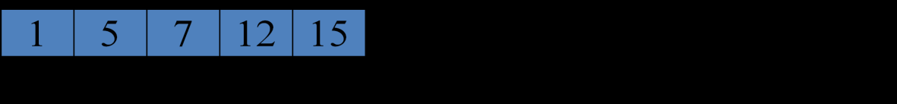
Binary Search
12
Example Binary Search :
0 1 2 3 4 5 6 7 8 9 10 11
0 1 2 3 4
3 4
3

Slide 30
Binary Search
#include <iostream>
using namespace std;
int binarySearch(int arr[], int value, int left, int right)
{
while (left <= right)
{
int middle = (left + right) / 2; // compute mid point.
if (arr[middle] == value)// found it. return position
return middle;
else if (arr[middle] > value) // repeat search in bottom half.
right = middle - 1;
else
left = middle + 1; // repeat search in top half.
}
return -1;
}

Slide 31
Binary Search
void main()
{
int x=0;
int myarray[10]={2,5,8,10,20,22,26,80,123,131};
cout<<"Enter a searched value : ";
cin>>x;
if(binarySearch(myarray,x,0,9)!=-1)
cout<<"The searched value found at position : "<<binarySearch(myarray,x,0,9)<<endl;
else
cout<<"Not found"<<endl;
}

Slide 32
Exercise
Exercise #1 :
Write a C++ program that define an array myarray of type integer with the elements (10,30,5,1,90,14,50,2). Then the user can enter any number and found if it is in the array or not.
Use linear search.
Edit the previous program and use binary search.

