Slide 1
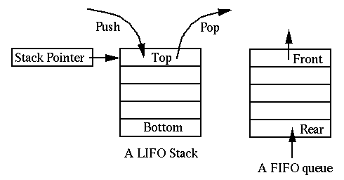
LAB#5
Stacks &
Queue

Slide 2
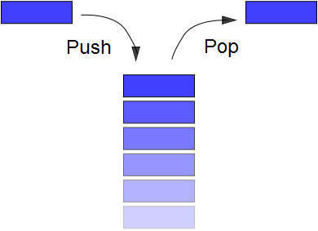
Stack:
Queue:
Allows access to only the last item inserted.
An item is inserted or removed from the “top” of the stack.
This mechanism is called Last-In-First-Out (LIFO).
A Stack Applet example
similar to stack, except that the first item to be inserted is the first one to be removed.
An item is inserted from “rear” and removed from “front “ of the queue.
This mechanism is called First-In-First-Out (FIFO).

Slide 3
Stack: Primary operations
Push: Add an element to the top of the stack from the top
Pop: Remove the element at the top of the stack from the top
empty stack
push an element
push another
pop
top
B
top
top
top
A
A
A
Queue : Primary operations
  enqueue: insert an element at the rear of the list from the rear.
dequeue: delete the element at the front of the list from the front.
Remove
(Dequeue)
Insert
(Enqueue)
front
rear

Slide 4
Operations of Stack
  IsEmpty: return true if stack is empty, return false otherwise
  Top: return the element at the top of stack
  Push: add an element to the top of stack
  Pop: delete the element at the top of stack
  DisplayStack: print all the data in the stack
Operations of Queue
  IsEmpty: return true if queue is empty, return false otherwise
  Enqueue: add an element to the rear of queue
  Dequeue: delete the element at the front of queue
  DisplayQueue: print all the data
  Rear: return the element at the last of queue
  Front: return the element at the first of queue

Slide 5
The same
A Simple Stack Class:
We use two classes: Node and Stack
  Declare IntNode class for the nodes
A Simple Queue Class:
We use two classes: Node and queue
  Declare IntNode class for the nodes
class IntNode
{
public :
IntNode(int el, IntNode *ptr = 0)
{data = el; next = ptr;}
int data;
IntNode *next;
};
class IntNode
{
public :
IntNode(int el, IntNode *ptr = 0)
{data = el; next = ptr;}
int data;
IntNode *next;
};

Slide 6
A Simple Stack Class:
  Declare stack class which contains :
A Simple Queue Class:
  Declare queue class which contains :
class stack {
public:
stack( )
{head =0;count=0;}
bool isempty( );
void push(int);
int pop( );
int top( ); //display the top
int stackCount();
void Displaystack( );
void clear( );
private:
intNode *head;
int count;};
class queue{
public:
queue( )
{head =0; tail=0;count=0;}
bool isempty( );
Void enqueue (int);
int dequeue( );
int rear( ); // display the rear
Int front ();// display the front
int queueCount();
void Displayqueue( );
void clear( );
private:
intNode *head, *tail;
int count;};

Slide 7
The same
A Simple Queue Class:
  Declare queue Class member function:
  1- bool isempty( );
A Simple Stack Class:
  Declare stack Class member function:
  1- bool isempty( );
bool stack::isempty( )
{
if (head==0)
return 1;
else
return 0;
}
bool queue ::isempty( )
{
if (head==0)
return 1;
else
return 0;
}

Slide 8
A Simple Stack Class:
  Declare stack Class member function:
  2- void push(int);
A Simple Stack Class:
  Declare stack Class member function:
  2- void enqueue(int);
Like add to head
Like add to tail
void stack::push(int data)
{
IntNode *newnode;
newnode = new IntNode(data,0);
newnode->next = head;
head = newnode;
count++;
}
OR void stack::push(int data)
{
head=new IntNode(data,head);
count++;
}
void queue::enqueue(int data)
{
if (tail != 0) // if queue not empty
{
tail->next = new IntSLLNode(data,0);
tail = tail->next; }
else
head = tail = new IntSLLNode(data,0);
count++;
}

Slide 9
The same
A Simple Stack Class:
  Declare stack Class member function:
  3- int pop( );
A Simple Queue Class:
  Declare queue Class member function:
  3- int dequeue( );
Like delete from head
Like delete from head
int stack::pop( )
{
int val=0;
if(head!=0)//if it not empty
{ val = head->data;
head = head->next; }
count--;
return val;
}
int queue:: dequeue( )
{
int val=0;
if(head!=0)//if it not empty
{ val = head->data;
head = head->next; }
if(head==0 )//if it empty
tail=head;
count--;
return val;
}

Slide 10
A Simple Stack Class:
  Declare stack Class member function:
  4- int top( );
A Simple queue Class:
  Declare queue Class member function:
  4- int front( );
int stack::top( )
{
if(!isempty( ))
return head->data;
}
The same
int queue::front( )
{
if(!isempty( ))
return head->data;
}
  5- int rear( );
int queue::rear( )
{
if(!isempty( ))
return tail->data;
}

Slide 11
The same
A Simple queue Class:
  Declare queue Class member function:
  6- int queueCount();
A Simple Stack Class:
  Declare stack Class member function:
  5- int StackCount();
int stack:: stackCount()
{
return count;
}
int queue:: queueCount()
{
return count;
}

Slide 12
The same
A Simple queue Class:
  Declare queue Class member function:
  5- void Displayqueue( );
A Simple Stack Class:
  Declare stack Class member function:
  5- void Displaystack( );
void stack::Displaystack( )
{
IntNode *current;
current = head;
while(current != 0)
{
cout << current->data << " " << current << "\n";
current=current->next;
}
cout << "----------------------" << "\n";
}
void queue::Displayqueue( )
{
IntNode *current;
current = head;
while(current != tail->next)
// OR while(current !=0)
{
cout << current->data << " " << current << "\n";
current=current->next;
}
cout << "----------------------" << "\n";
}

Slide 13
The same
A Simple queue Class:
  Declare queue Class member function:
  6- void clear( );
A Simple Stack Class:
  Declare stack Class member function:
  6- void clear( );
void stack::clear( )
{
head =0; count=0;
}
void queue::clear( )
{
head = tail =0; count=0;
}

Slide 14
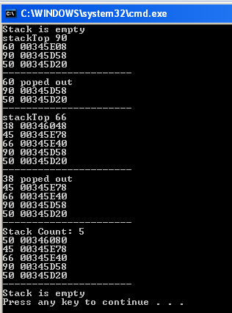
Stacks
void main( )
{
stack mag;
if(mag.isempty( )) cout << "Stack is empty \n";
else cout << "Stack is not empty \n";
mag.push(50);
mag.push(90);
cout << "stackTop " << mag.top( ) << "\n";
mag.push(60);
mag.Displaystack( );
cout << mag.pop( ) << " poped out \n";
mag.Displaystack( );
mag.push(66);
cout << "stackTop " << mag.top( ) << "\n";
mag.push(45);
mag.push(38);
mag.Displaystack( );
cout << mag.pop( ) << " poped out \n";
mag.Displaystack( );
mag.push(50);
cout << "Stack Count: " << mag.stackCount()<< "\n";
mag.Displaystack( );
mag.clear( );
if(mag.isempty( )) cout << "Stack is empty \n";
else cout << "Stack is not empty \n";
}

Slide 15
Queue
void main( )
{
if(mag.isempty( )) cout << "queue is empty \n";
else cout << "queue is not Queue mag;
mag.enqueue(50);
mag.enqueue(90);
cout << "front " << mag.front( ) << "\n";
mag.enqueue(60);
mag.Displayqueue( );
cout << mag.dequeue( ) << " dequeueout \n";
mag.Displayqueue( );
mag.enqueue(66);
cout << "rear " << mag.rear( ) << "\n";
mag.enqueue(45);
mag.enqueue(38);
mag.Displayqueue( );
cout << mag.dequeue( ) << " dequeue out \n";
mag.Displayqueue( );
mag.enqueue(50);
cout << "queue Count: " << mag.queueCount()<< "\n";
mag.Displayqueue( );
mag.clear( );
if(mag.isempty( )) cout << "queue is empty \n";
else cout << "queue is not empty \n";
}

Slide 16
Evolution question
Q: Assume that you have stack of integers S, queue of integers Q
queue Q;
stack S;
Q. enqueue (77);
Q. enqueue (66);
Q. enqueue (55);
Q. enqueue (44);
Q. enqueue (33);
Q. enqueue (22);
Q. enqueue (11);
while(Q.front() != 44)
{
S.push(Q.size());
Q. dequeue ();
}
Fill the content of S and Q after the execution of the following operations:
top
5
6
7
rear
front
11 | 22 | 33 | 44 | 55 | 66 | 77
Queue Q
Stack S

Slide 17
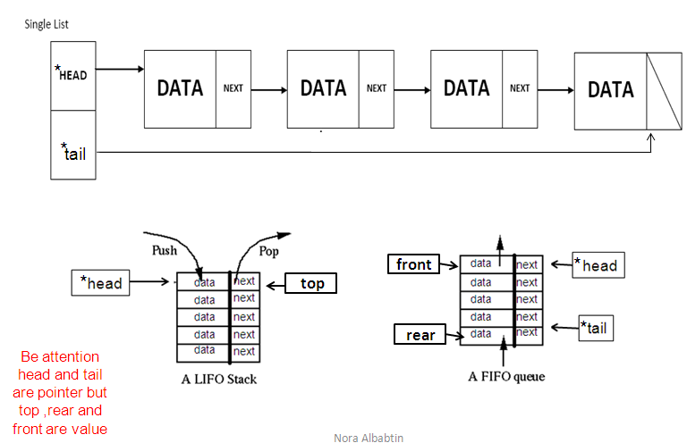
Comparisons between lined list & stack & queue
Note: we can not put tail pointer in the stack because we have one hole in the top which we can do the removing and inserting operation from it , but queue opposite that we have two hole
front
top

