Slide 1
LAB#3
Stacks

Slide 2
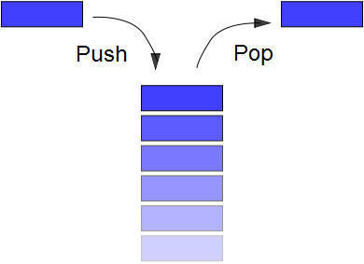
Stack:
Allows access to only the last item inserted.
An item is inserted or removed from the “top” of the stack.
This mechanism is called Last-In-First-Out (LIFO).
A Stack Applet example

Slide 3
Stack: Primary operations
Push: Add an element to the top of the stack from the top
Pop: Remove the element at the top of the stack from the top
empty stack
push an element
push another
pop
top
B
top
top
top
A
A
A

Slide 4
Operations of Stack
  IsEmpty: return true if stack is empty, return false otherwise
  Top: return the element at the top of stack
  Push: add an element to the top of stack
  Pop: delete the element at the top of stack
  DisplayStack: print all the data in the stack

Slide 5
The same
A Simple Stack Class:
We use two classes: Node and Stack
  Declare IntNode class for the nodes
class IntNode
{
public :
IntNode(int el, IntNode *ptr = 0)
{data = el; next = ptr;}
int data;
IntNode *next;
};

Slide 6
A Simple Stack Class:
  Declare stack class which contains :
class stack {
public:
stack( )
{head =0;count=0;}
bool isempty( );
void push(int);
int pop( );
int top( ); \\display the top
int stackCount();
void Displaystack( );
void clear( );
private:
intNode *head;
int count};

Slide 7
The same
A Simple Stack Class:
  Declare stack Class member function:
  1- bool isempty( );
bool stack::isempty( )
{
if (head==0)
return 1;
else
return 0;
}

Slide 8
A Simple Stack Class:
  Declare stack Class member function:
  2- void push(int);
Like add to head
void stack::push(int data)
{
IntNode *newnode;
newnode = new IntNode(data,0);
newnode->next = head;
head = newnode;
count++;
}
OR void stack::push(int data)
{
head=new IntNode(data,head);
count++;
}

Slide 9
The same
A Simple Stack Class:
  Declare stack Class member function:
  3- int pop( );
Like delete from head
int stack::pop( )
{
int val=0;
if(head!=0)\\if it not empty
{ val = head->data;
head = head->next; }
count--;
return val;
}

Slide 10
A Simple Stack Class:
  Declare stack Class member function:
  4- int top( );
int stack::top( )
{
if(!isempty( ))
Return head->data;
}

Slide 11
A Simple Stack Class
  Declare stack Class member function:
  5- int StackCount();
int stack:: stackCount()
{
return count;
}

Slide 12
A Simple Stack Class
  Declare stack Class member function:
  5- void Displaystack( );
void stack::Displaystack( )
{
IntNode *current;
current = head;
while(current != 0)
{
cout << current->data << " " << current << "\n";
current=current->next;
}
cout << "----------------------" << "\n";
}

Slide 13
A Simple Stack Class
A Simple Stack Class:
  Declare stack Class member function:
  6- void clear( );
void stack::clear( )
{
head = 0; count=0;
}

Slide 14
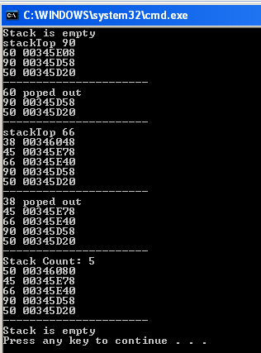
Stacks
void main( )
{
stack mag;
if(mag.isempty( )) cout << "Stack is empty \n";
else cout << "Stack is not empty \n";
mag.push(50);
mag.push(90);
cout << "stackTop " << mag.top( ) << "\n";
mag.push(60);
mag.Displaystack( );
cout << mag.pop( ) << " poped out \n";
mag.Displaystack( );
mag.push(66);
cout << "stackTop " << mag.top( ) << "\n";
mag.push(45);
mag.push(38);
mag.Displaystack( );
cout << mag.pop( ) << " poped out \n";
mag.Displaystack( );
mag.push(50);
cout << "Stack Count: " << mag.stackCount()<< "\n";
mag.Displaystack( );
mag.clear( );
if(mag.isempty( )) cout << "Stack is empty \n";
else cout << "Stack is not empty \n";
}

