Slide 1
LAB#1 : Arrays & Functions

Slide 2
Arrays
What is an array?
Initializing arrays
Accessing the values of an array
Multidimensional arrays

Slide 3
Exercise:
Write a C++ program that reads n integers in an array of maximum size 14. After that your program should do the following:
Print the array elements.
Modify the array element such that the element that is even and multiple of 100 will be duplicated and store the result in the same element.
Print the array after modifications.
Print the number of elements that is even and multiple of 100.

Slide 4
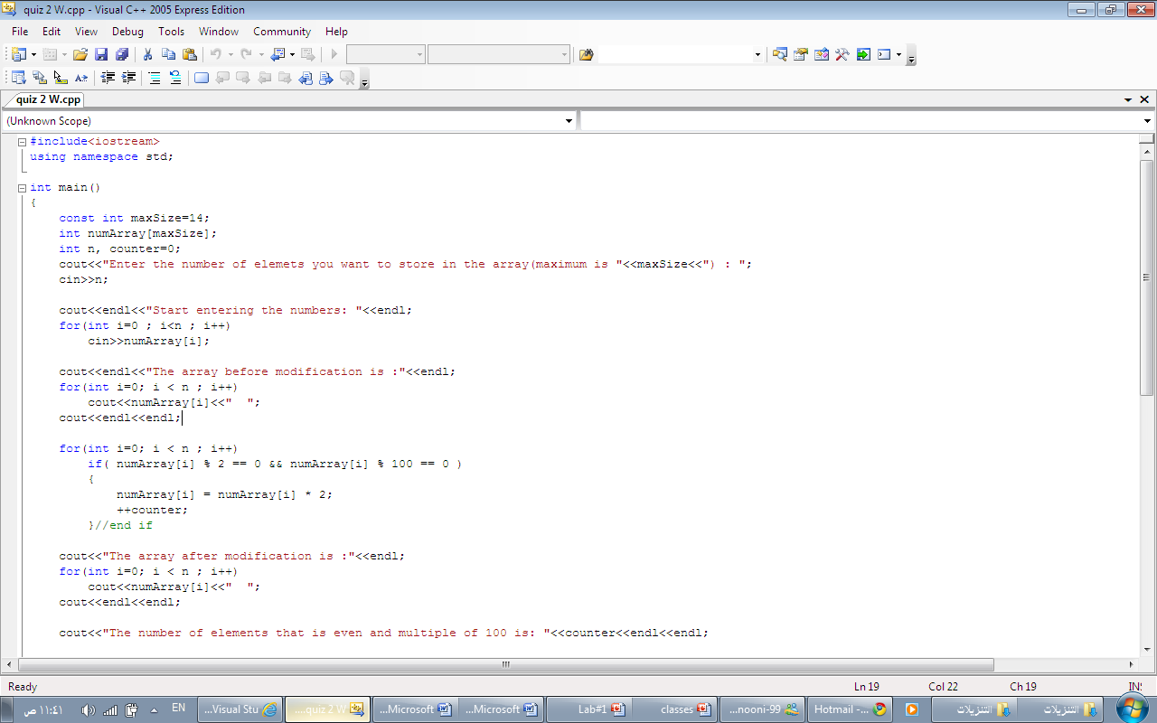

Slide 5
Functions

Slide 6
Functions
Define Function
DataType name (parameter1,…){ statements}
Function with no type.
Arguments passed by value and by reference.
Recursivity.
The Prototype of the function
DataType name (parameter1,…);

Slide 7
Ex#1:
Trace the following programs, and show the output:

Slide 8
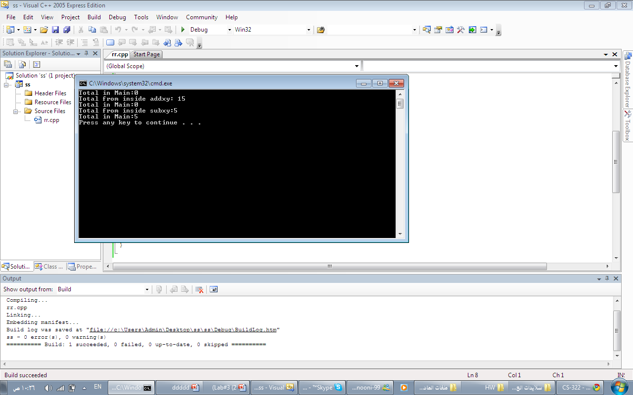
#include<iostream>
using namespace std;
void printtotal(int );
void addxy(int , int , int );
void subxy(int , int , int& );
void main()
{
int x, y, total;
x = 10;
y = 5;
total = 0;
printtotal(total);
addxy(x, y, total);
printtotal(total);
subxy(x, y, total);
printtotal(total);
}
void printtotal(int total) {
cout<<"Total in Main:" << total<<endl ;
}
void addxy(int x, int y, int total) {
total = x + y;
cout<<"Total from inside addxy: "<< total<<endl;
}
void subxy(int x, int y, int &total) {
total = x - y;
cout<<"Total from inside subxy:" << total<<endl ;
}

Slide 9
Separating Classes into Files
What are the benefit of separating classes in to files ?
Normally, to do the separation, the class declaration is placed in one file (header file), and the implementation of all the methods is put in another file.
The class declaration file is normally called ClassName.h.
The implementation file is normally called ClassName.cpp.
Then you include the header file in your program with an #include directive.

Slide 10
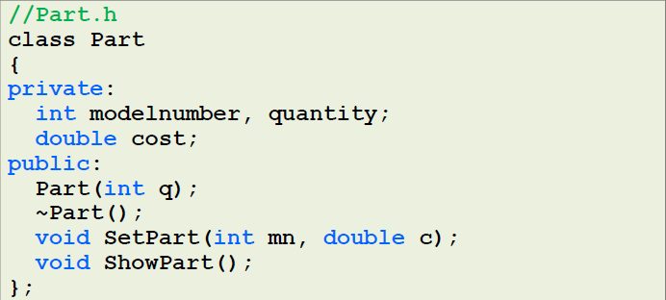
However, instead of including two files (ClassName.h and ClassName.cpp), you have to include only ClassName.h.
The compiler will include the .cpp file automatically
Don’t forget: the two files need to be in the same directory to achieve that).

Slide 11
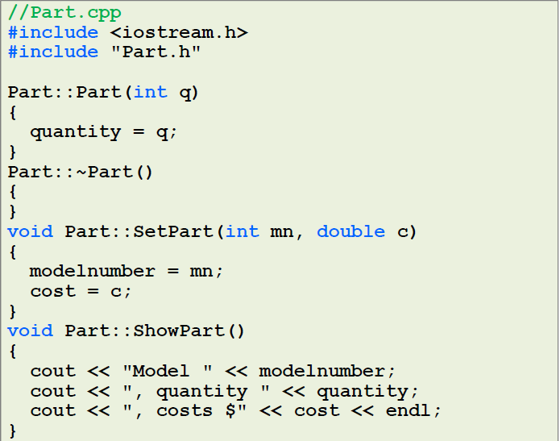

Slide 12
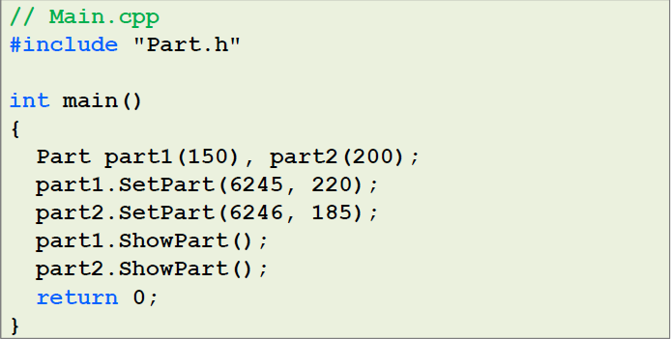

Slide 13
Evaluation Question
Exercise#1:
Write a C++ program that defines array enable user to enter the elements of type integer, then print the sum of all elements.

Slide 14
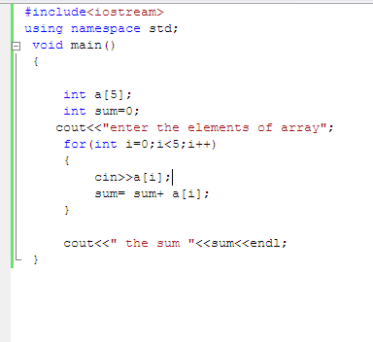
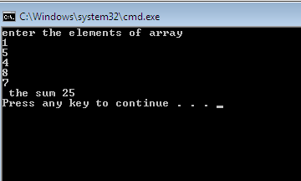
Answer of Evaluation Question

Slide 15
Pointers
Lab#2

Slide 16
So what is a pointer?
A pointer is a variable which contains the address in memory of another variable. We can have a pointer to any variable type.
we can use pointers with:
Arrays,
Structures,
Functions.

Slide 17
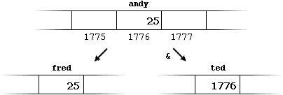
Pointers
Reference operator (&)
"address of"
andy = 25;
fred = andy;
ted = &andy;

Slide 18
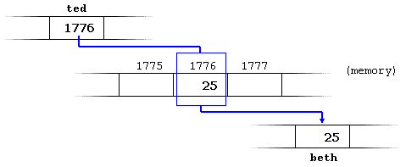
Pointers
Deference operator (*)
"value pointed by“
andy = 25;
ted = &andy;
beth = *ted;

Slide 19
Declaring variables of pointer types
int * numberPtr;
char * characterPtr;
float * greatnumberPtr;
int * mPtr, * nPtr, *j;

Slide 20
Pointer initialiazation
  Pointer to specific address:
  int number;
  int *tommy = &number;
  Pointer to nothing
  int *tommy = NULL;
  equivalents to
  int *tommy = 0;

Slide 21
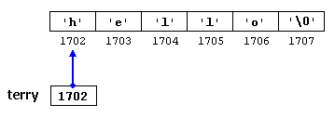
Pointer initialiazation
Strings as pointer to characters
char * terry = "hello";
The fifth element can be accessed with:
*(terry+4) or terry[4]

Slide 22
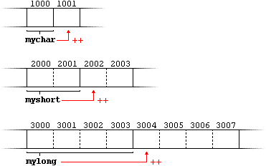
Pointer Arthematic
  Suppose the following piece of code:
  char *mychar;
  short *myshort;
  long *mylong;
  mychar++;
  myshort++;
  mylong++;
  (++) and (--) operators have greater operator precedence than the dereference operator (*).

Slide 23
Ex#1: Trace the code below
  int main (){
  int firstvalue = 5, secondvalue = 15;
  int * p1, * p2;
  p1 = &firstvalue; //p1 = address of firstvalue
  p2 = &secondvalue; //p2 = address of secondvalue
  *p1 = 10; //value pointed by p1 = 10
  *p2 = *p1; //value pointed by p2=value pointed by p1
  p1 = p2; // p1 = p2 (value of pointer is copied)
  *p1 = 20; // value pointed by p1 = 20
  cout << "firstvalue is " << firstvalue << endl;
  cout <<"secondvalue is " << secondvalue << endl; return 0;}
firstvalue is 10
secondvalue is 20

Slide 24
Ex#2: Pointers and Arrays (Trace)
  int main ()
  {
  int numbers[5];
  int * p;
  p = numbers; *p = 10;
  p++; *p = 20;
  p = &numbers[2]; *p = 30;
  p = numbers + 3; *p = 40;
  p = numbers; *(p+4) = 50;
  for (int n=0; n<5; n++)
  cout << numbers[n] << ", ";
  return 0;
  }
10, 20, 30, 40, 50,

Slide 25
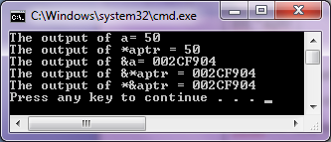
Ex#3: What is the output
void main ()
{
int a = 50;
int *aptr ;
aptr = &a;
// assume that aptr=0x0018FF44
cout <<"The output of a= "<<a << "\n";
cout <<"The output of *aptr = "<<*aptr << "\n";
cout <<"The output of &a= "<<&a << "\n";
cout <<"The output of &*aptr = "<<&*aptr << "\n";
cout <<"The output of *&aptr = "<<*&aptr << "\n";
}

Slide 26
Evaluation Question
Assume we have char array called str which have 4 capital litters( elements) , like this:
char Str[]="ABCD";
Required: print this array in this form " AbcD ".
Hint : use pointer.

Slide 27
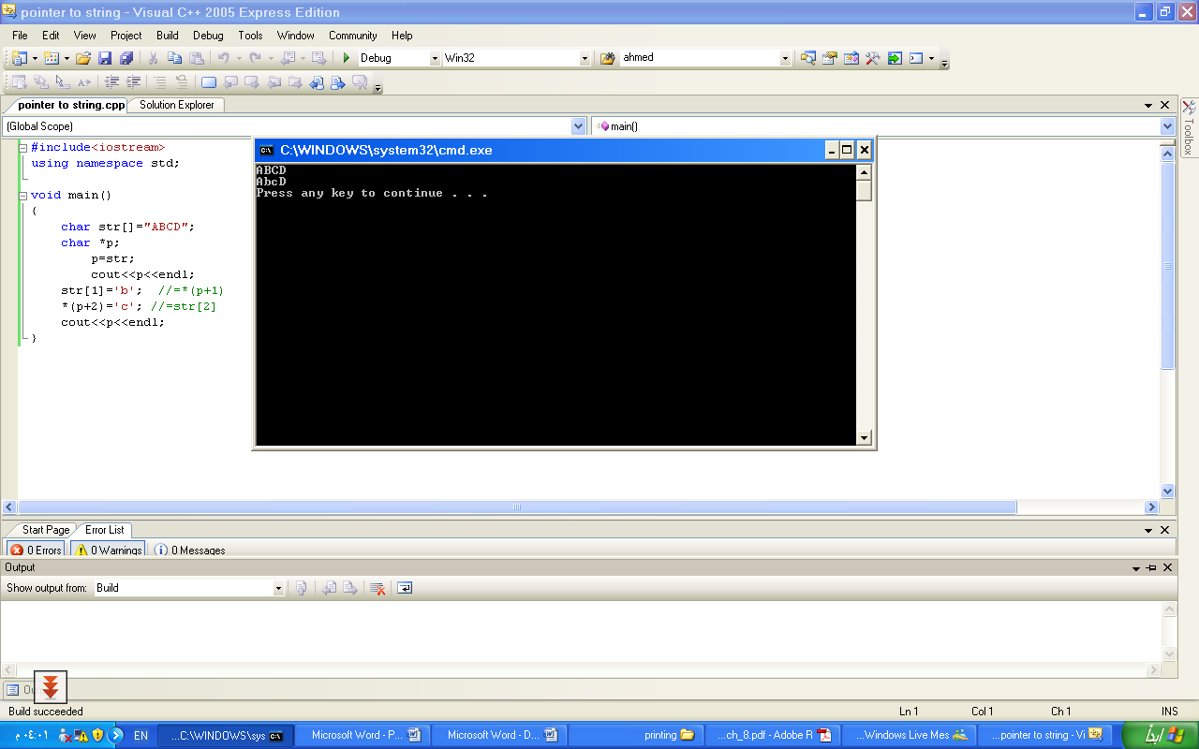
Answer of Evaluation Question

Slide 28
Lab#3
Classes

Slide 29
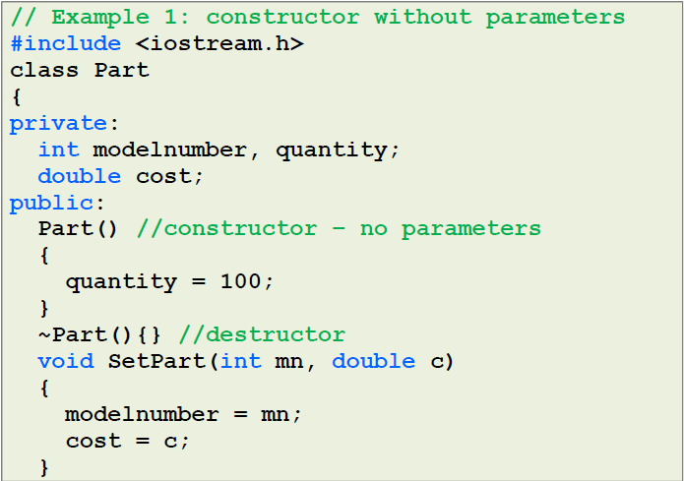

Slide 30
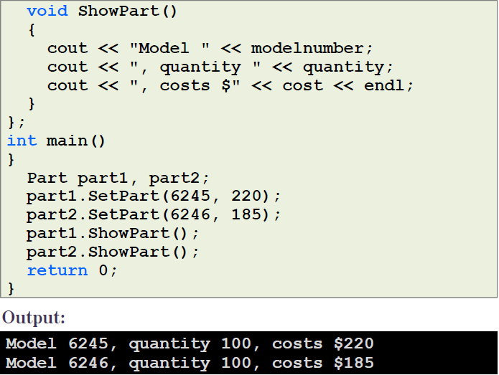

Slide 31
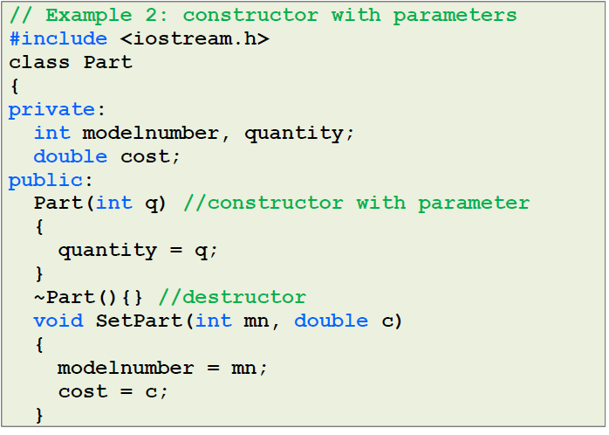

Slide 32
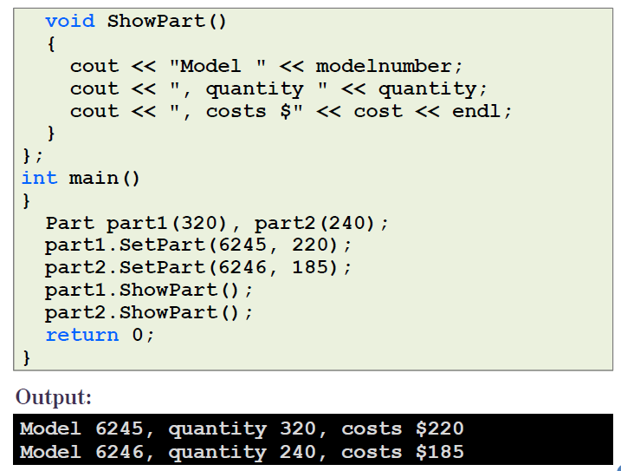

Slide 33
Exercise#1:Trace the code below
#include <iostream>
#include <string>
using namespace std;
class person
{
private:
string name;
int age;
public:
person();
person(string , int );
void set(string,int);
string getname();
int getage();
};

Slide 34
Exercise#1:Trace the code below
person::person()
{
name="NO Name";
age=0;
}
person::person(string pn,int pa)
{
name=pn;
age=pa;
}

Slide 35
Exercise#1:Trace the code below
void person::set(string n, int a)
{
name=n;
age=a;
}
string person::getname()
{
return name;
}
int person::getage()
{
return age;
}

Slide 36
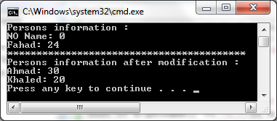
Exercise#1:Trace the code below
int main()
{
person a;
person b("Fahad",24);
cout<<"Persons information : "<<endl;
cout << a.getname() << ": " << a.getage() <<endl;
cout << b.getname() << ": " << b.getage() << endl;
cout<<"*****************************************"<<endl;
a.set("Ahmad",30);
b.set("Khaled", 20);
cout<<"Persons information after modification : "<<endl;
cout << a.getname() << ": " << a.getage() <<endl;
cout << b.getname() << ": " << b.getage() << endl;
return 0;
}

Slide 37
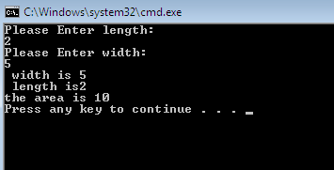
Exercise#2
Define a class Rectangle which contains:
Data members: length and width.
Member functions:
  Function area() to compute the area of the rectangle.
  Function getdata( ) to prompt the user to enter the length and width for a rectangle.
  Function showdata( ) to display length, width and area of a rectangle

Slide 38
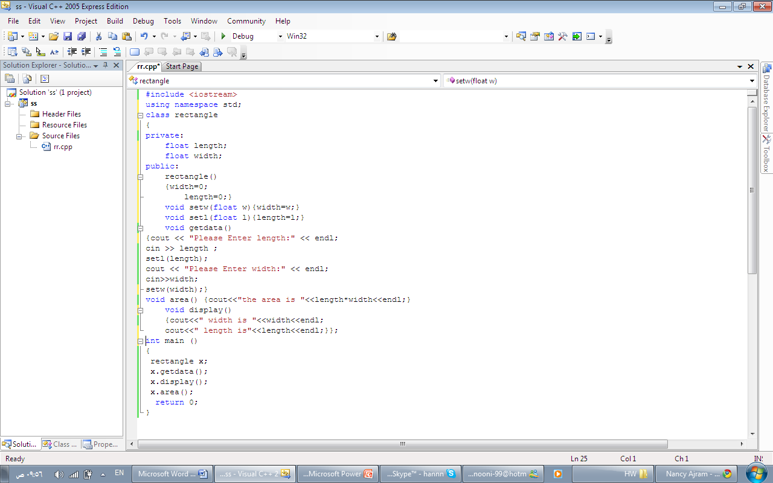
Answer of Exercise#2

